Slide 1
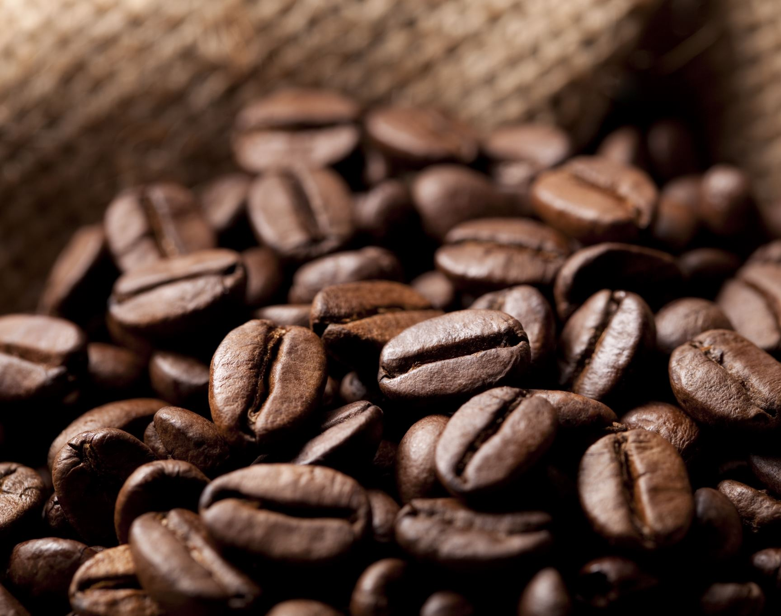
Coffee CO Sales 2021: A Fresh Look with Historical Grounds

Slide 2

Grounds of 2021
Brew of 2021: Sales Metrics Snapshot
Behind the Brew: Customer Behavior Insights

Slide 3

2021 Sales Snapshot

Slide 4
Year By Year Sales Comparison
In 2021, Coffee Co. sales jumped by 13% compared to 2020. and 15% compared to 2019.
This chart displaces the combined sales of Quarter 1 and 2 for each year, This chart also displaces the total of year years sales to date.

Slide 5
Sales By Region
In 2021, sales in the United States and Ireland increased by nearly 20% each.
Conversely sales in the United Kingdom declined by 40%,

Slide 6
Customer Behavior
What shifted in our customers’ preferences in 2021?

Slide 7
Spending Habits
In 2020 and 2021, we saw our customers spend the most in the fall season.
Fall sales accumulated 42% of annual sales in 2021

Slide 8
Coffee Bag Preferences
In the fall of 2021, a surge of 1.0 kg bags was sold.
The 0.5 kg bags saw an increase in sales in the surrounding months."

Slide 9
Coffee Type Popularity
Between 2019 and 2021, Arabica saw a continuous increase in sales, pulling ahead as the most popular flavor.

Slide 10
Member/ Non Member Orders
A significant driver of increased sales in 2021 was Non-Member purchases, which increased by over 40 customers. Compared to the previous two years.

Slide 11
Customer Retention By Year
in 2019 3 out of 259 customers returned in 2020
in 2020 8 out of 263 customers returned in 2020
In the past two years, few customers returned to make a purchase the following year.

Slide 12
Returning Customers By Type
More returning customers are non-members.
Out of all customers from 2019 to 2022, 51 have returned to make another purchase.
Of those 51 returning customers who bought coffee at any time, only 21% were members.

Slide 13
Other Considerable Changes
The highest sales driver in 2021 isn’t dependent on blend price anymore.
Sales by popularity are more impactful than sales of high-priced items.
More of less is better.
Liberica - Highest Priced Type
Excelsa - 2nd highest Price Type
Arabica - 3rd Highest priced Type
Robusta - Cheapest Type

Slide 14
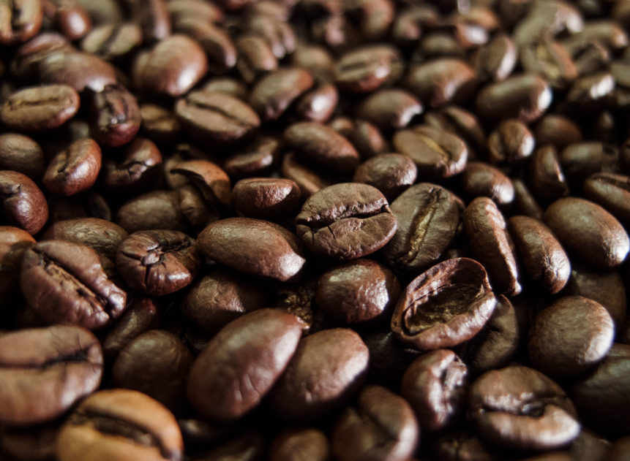
Summary
Sales increased by 13% in 2021
Future sales increases tailor flavor popularity
Preferred sizes for customers tends to be 1.0kg bags
Fall seasons are Peak for not only sales but new customers
Customers return by years is low less than 1%
Members have little incentive to make multiple purchases

Slide 15
Points of Focus
Customer Retention (how to get customers to come back)
Membership value consideration (Benefits of having a Membership)
Recourse Planning around Popular seasons (Prioritize spending or campaigning around peak seasons)
Getting Customers to spend More often rather than spending more. (Focus incentivizing flavors by popularity regardless of product price)

